Slide 1

Got Gainz
Tony Nguyen, David Quines, Jane Cabanayan, Ben La France
Software Engineering Project
Spring 2020
Professor Amini

Slide 2

Agenda
About Our App 5. Demo (Recorded)
Designated Roles 6. Challenges
Approach 7. Future Ideas
Components 8. What We Learned

Slide 3
Got Gainz:
A Fitness Mobile App
With Web App

Slide 4
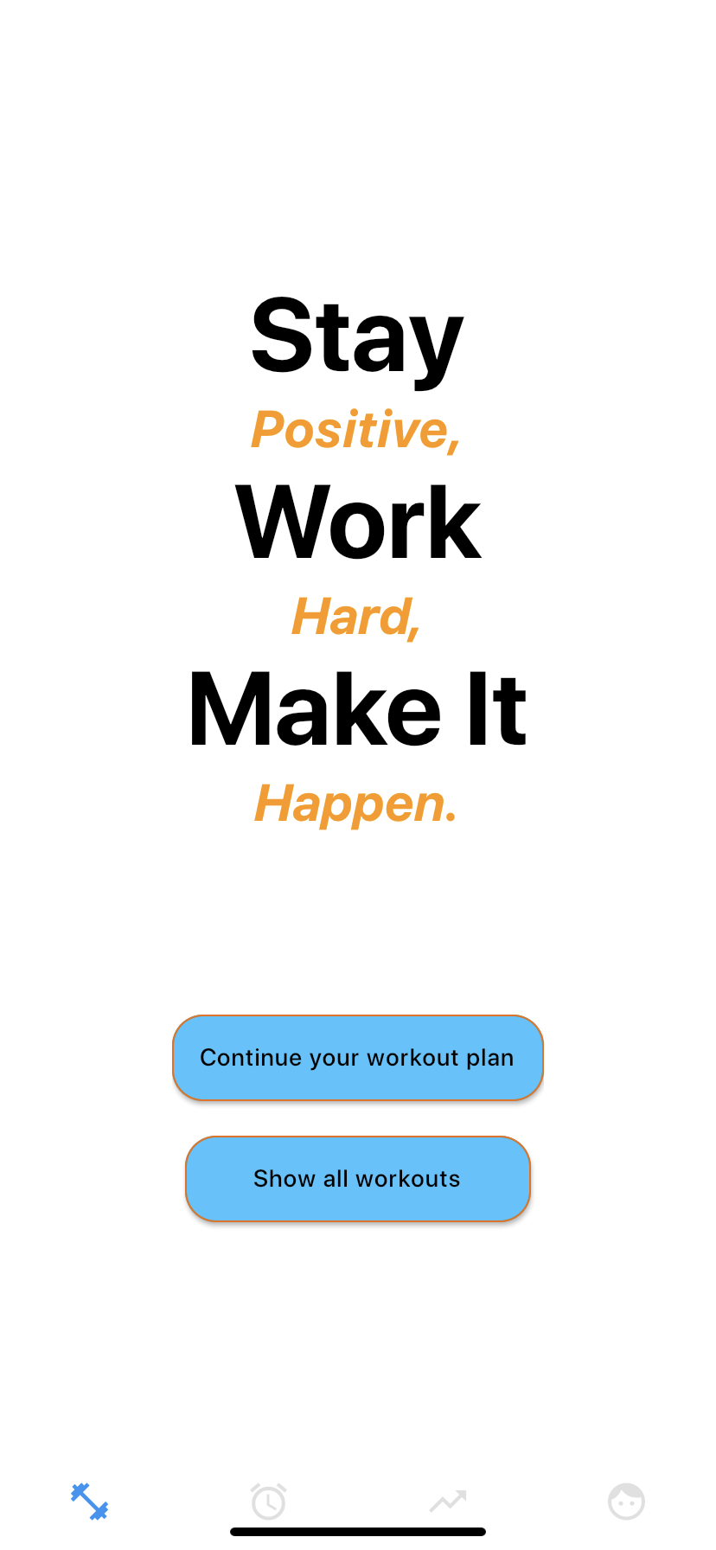
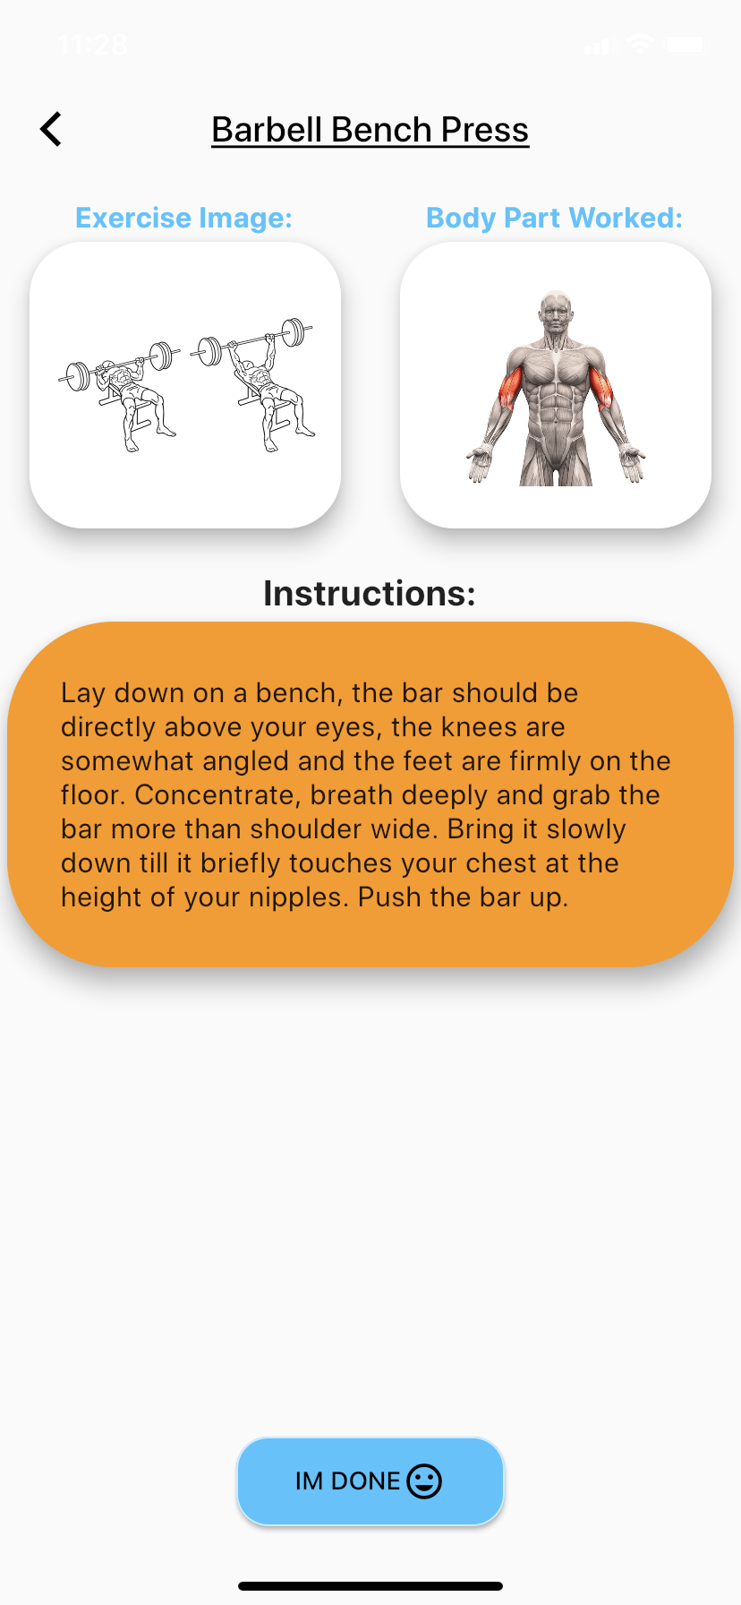
Mobile Application: Got Gainz
Create a Fitness App
Provide workout plans
Provide new plans
Provide feedback

Slide 5
Designated Roles
Team
Main design and vision for app
Design, Develop, Test, and Deployment
Requirements and Role Designation
Ben Timer + Stopwatch Feedback | David Lead Workout + Exercises API Lead Database Population | Jane Lead UI/UX Support DB Population Support Workout | Tony Onboarding Data Persistence Support UI/UX Project Management

Slide 6
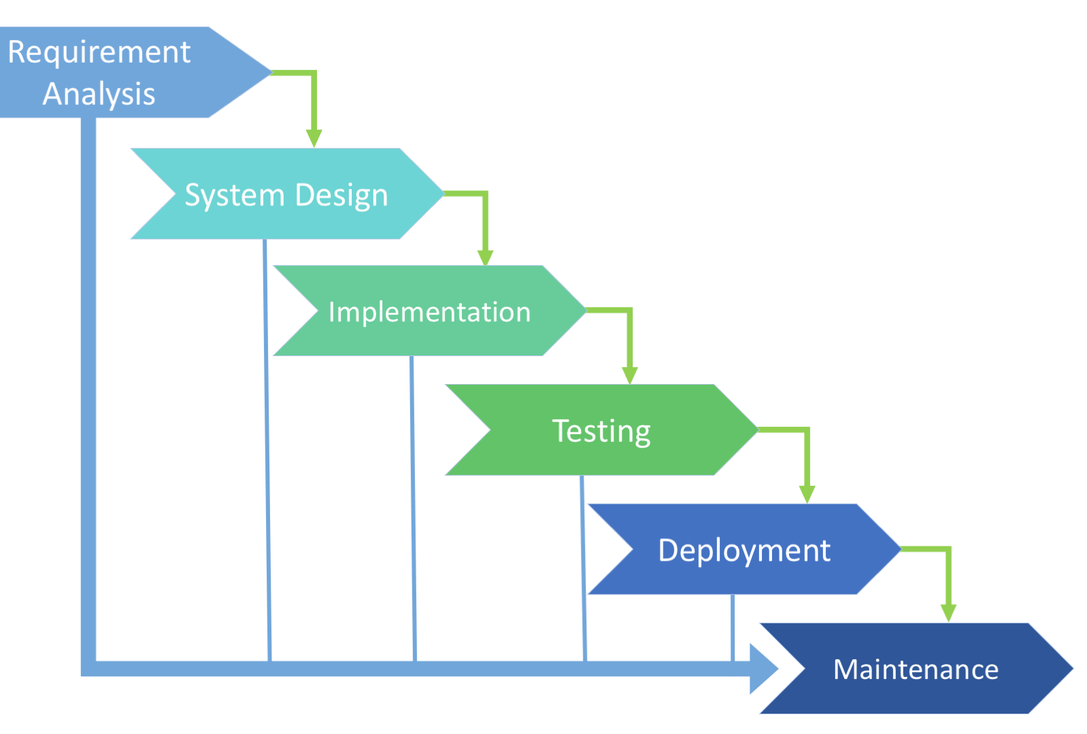
Approach
Project Requirements
Requirements for what’s possible with given timeframe
Design + Suggestion
Sprints
Onboarding Pages + Groundwork
API/JSON Implementation + Timer/Stopwatch
UI + Light Testing
Test Everything
Deployment
[ 1 ]

Slide 7
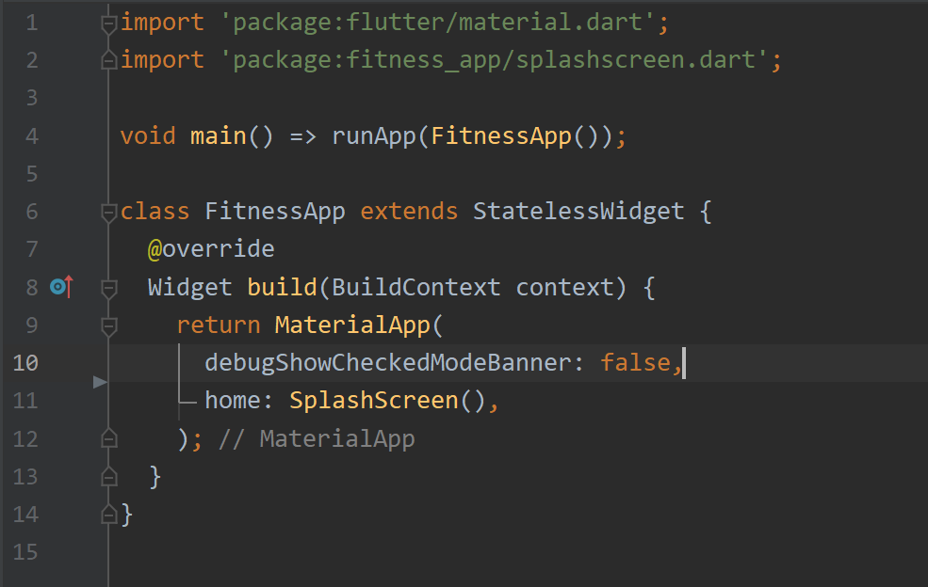
Components
Main Components
Flutter Framework
REST API/ JSON Serialization
SharedPreferences
Http
Secondary Components
GitHub Pages
GitHub file hosting
Discord

Slide 8
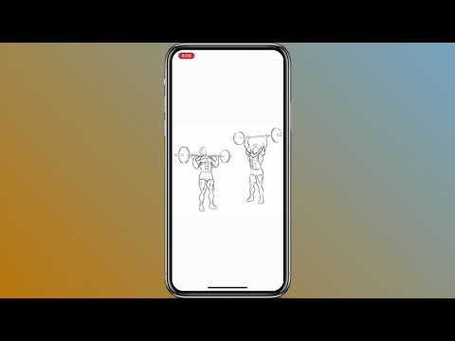
Demo
Try it yourself:
bit.ly/GotGainz
Notes:
Recorded?

Slide 9

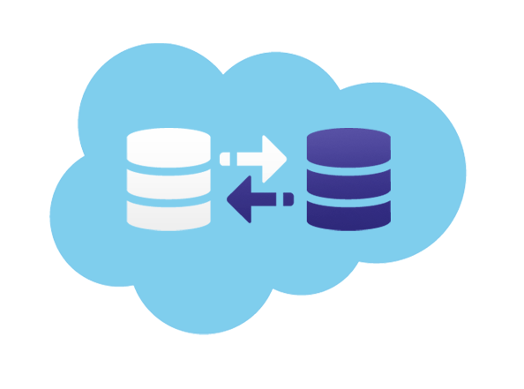
Challenges
Finding a database
Implementing a database
Learning Flutter
UI implementation
Properly persisting data
Flutter Web
[4]
[3]

Slide 10

Future Ideas
A database that allows read and write
Show required workout equipment
Push notifications
Make the app usable offline
Login + Signup for multiple users
Put app into mobile markets
[5]

Slide 11

What We Learned
Communicating Skills
Working in a team
We also learned
Flutter
Dart
Http Calls
Rest APIs
Data Manipulation
Data Persistence
[2]

Slide 12
And Remember...

Slide 13
References
[1] Image Source: https://existek.com/blog/sdlc-models/
[2] Image Source: https://sloanreview.mit.edu/wp-content/uploads/2015/03/kloppenborg-1200.jpg
[3] Image Source: https://skalabletech.com/wp-content/uploads/2019/10/crm_integration.png
[4] Image Source: https://matwrites.com/wp-content/uploads/2018/03/Flutter.png
[5] Image Source: https://i.pinimg.com/564x/d3/4c/c0/d34cc05e79dbe294b91bb02a2e10cefb.jpg
Project Ideas, Statement, and Requirements: https://docs.google.com/document/d/1tNIK3ZZ5Nv3q3iy1ZvAzbvsePSYjafDe45rEShBIH60/edit?usp=sharing (Needs CSUN email to view)

